Slide 1

Running python in web browser!

Slide 2

Supervisor
Dr. Mohammad Bagher Ghaznavi-Ghoushchi
Presenter
Melika Bahman Abadi
Nov 2020

Slide 3


Table of Contents
01
03
02
04
Introduction
Amazing Features
How login and create a colab note book.
Show interesting features of colab.
Resources Manager
Programming
How use TPU, GPU and use colab for long hours.
Some simple program with python.

Slide 4


01
Introduction

Slide 5


Why Colab?
TPU & GPU
Long time running
Pre-installed packages
Simultaneous coding
Code snipet
05/43

Slide 6

Why Colab?
Google services
Easy share
Heavy datasets
06/43

Slide 7
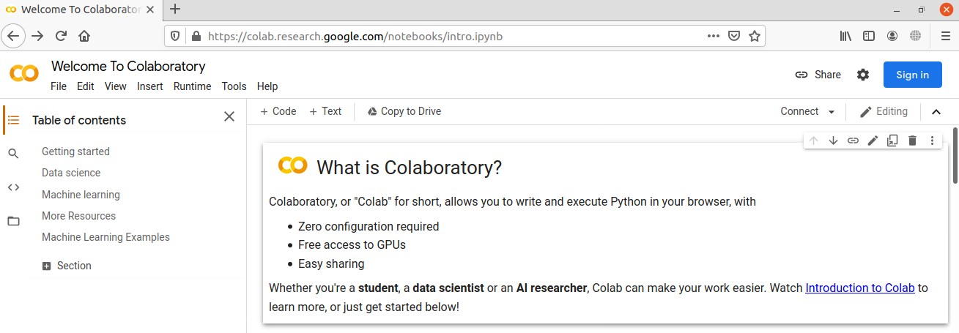
Start
Make a google account.
Go to https://colab.research.google.com/notebooks/intro.ipynb
Sign In.
07/43

Slide 8
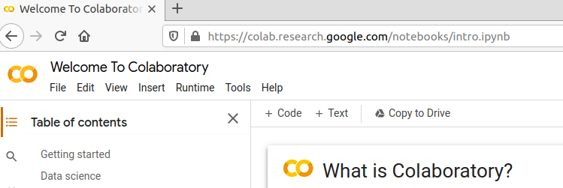
Start
File 🡺 New Notebook
08/43

Slide 9
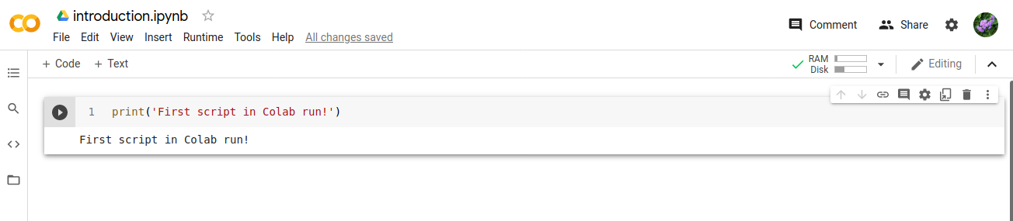
Running first script
1 🡺 Renaming file.
2 🡺 Running cell.
3 🡺 Adding new cell for code.
4 🡺 Adding new cell for writing.
Ctrl + Enter 🡺 Run
Shift + Enter 🡺 Run + New Cell
1
3
4
2
09/43

Slide 10
02
Resources Manager

Slide 11
Resources
RAM ~ 13 GB
Disk ~ 107 GB
11/43

Slide 12
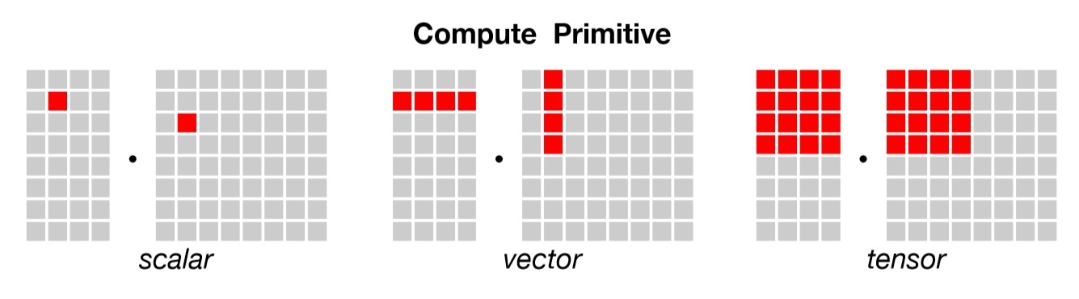
CPU vs. GPU vs. TPU
Meaning:
CPU: Control Processing Unit
GPU: Graphic Processing Unit
TPU: Tensor Processing Unit
The dimension of data are:
CPU: 1 X 1 data unit
GPU: 1 X N data unit
TPU: N X N data unit
https://iq.opengenus.org/cpu-vs-gpu-vs-tpu/
12/43

Slide 13
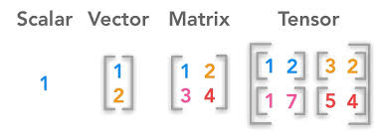
CPU vs. GPU vs. TPU
https://www.kdnuggets.com/2018/05/wtf-tensor.html
13/43

Slide 14
Usages
CPU:
*General programming problem.
*Simple models that don’t take long to train.
*Small models with small effective cluster sizes.
GPU:
* Graphics rendering.
* It’s used in larger models with larger effective cluster sizes.
* Efficient for programming problem with parallelization scope.
TPU:
* Models with dense matrix calculations.
* Models lasting weeks or months to train.
* Very large models with very large effective cluster sizes.
14/43

Slide 15
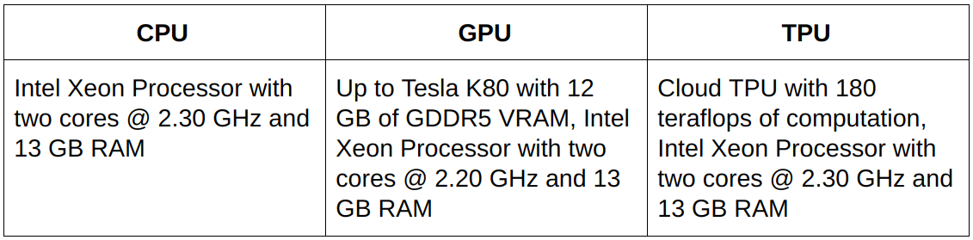
Usages
15/43

Slide 16
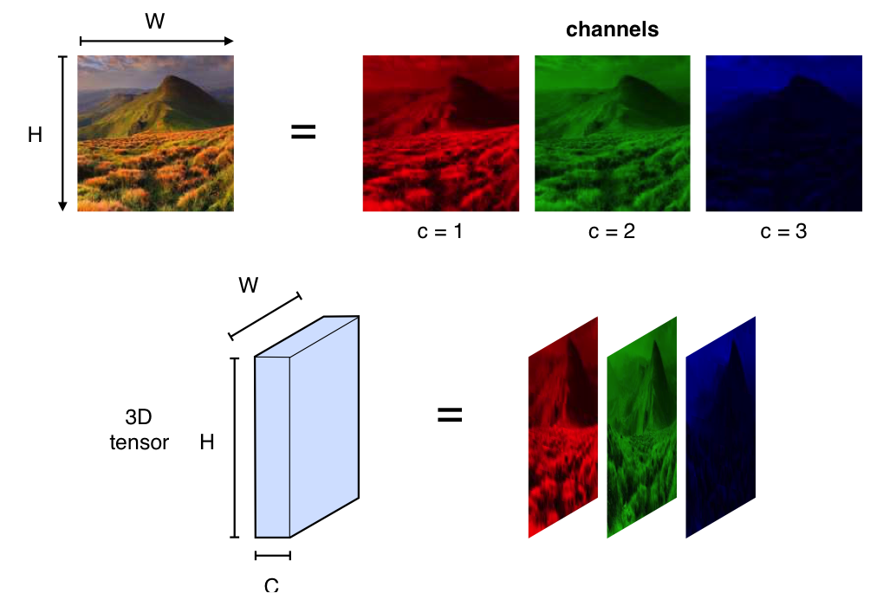
Tensors
https://www.di.ens.fr/~lelarge/dldiy/slides/lecture_6/index.html#36
16/43

Slide 17
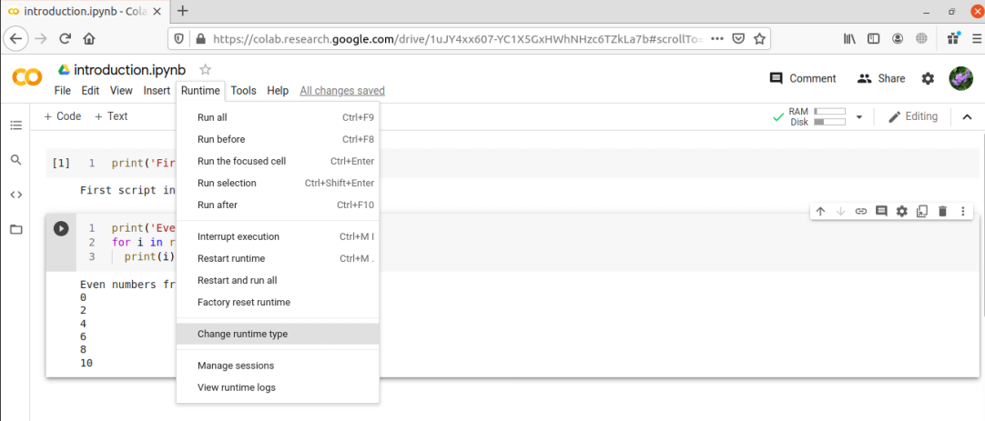
Resources
You can use hardware accelerator like GPU & TPU.
1
2
17/43

Slide 18
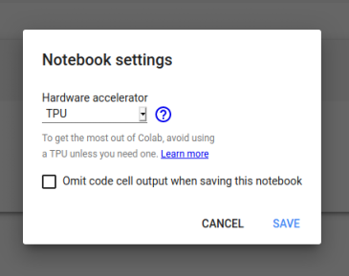
Resources
1 🡺 Select GPU or TPU as hardware accelerator.
2 🡺 If you don`t want to show output cell for
others when you share the notebook, check it.
1
2
18/43

Slide 19
03
Amazing Features

Slide 20
Stop Colab from disconnecting
When You are waiting for training after 90 minutes Clab disconnect if you did not click on page.
Run the following JavaScript code in Developer Tools.
function KeepClicking(){
console.log("Clicking");
document.querySelector("colab-toolbar-button#connect").click()
}setInterval(KeepClicking,60000)
Open Colab note book in chrome.
Press F12.
Write code in console tab.
It will click on page every 60 seconds so Colab think you`re codding ☺
20/43

Slide 21
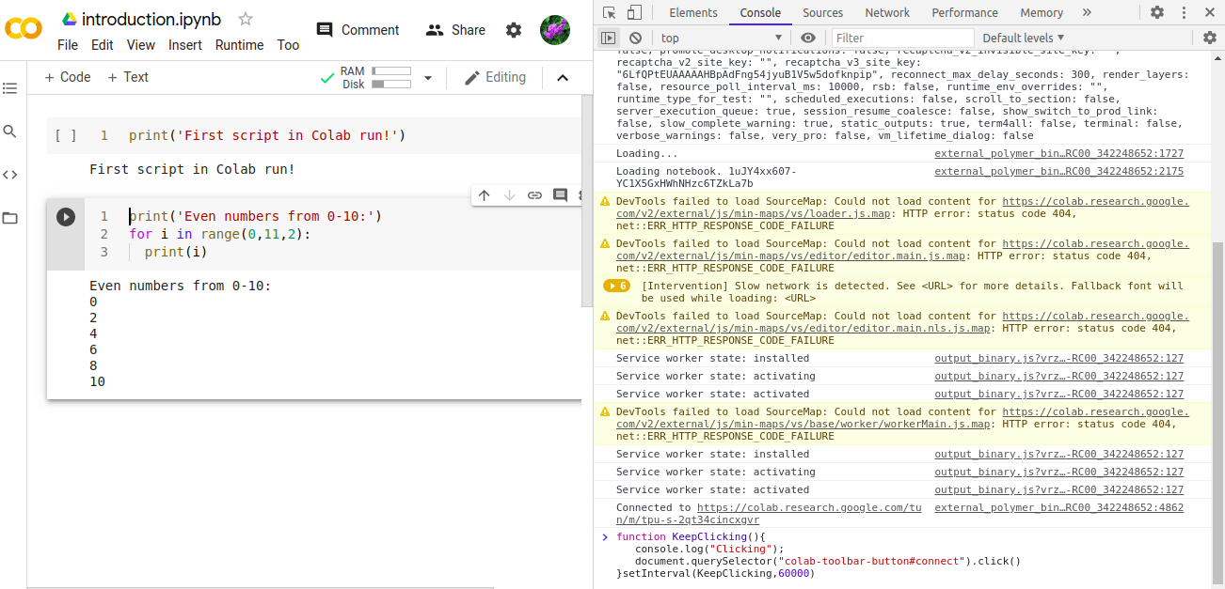
Stop Colab from disconnecting
21/43

Slide 22
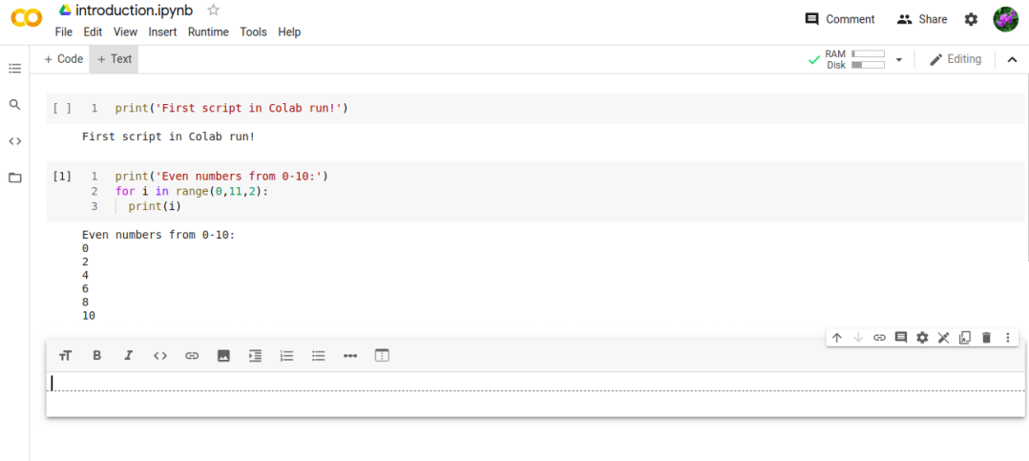
Snippets in Colab
Write your custom snippets in colab cell.
1
2
22/43

Slide 23
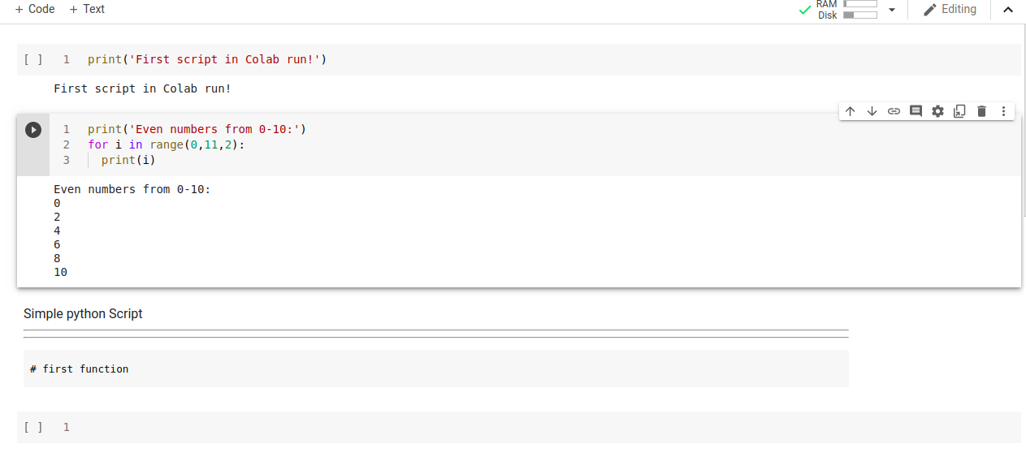
Snippets in Colab
23/43

Slide 24
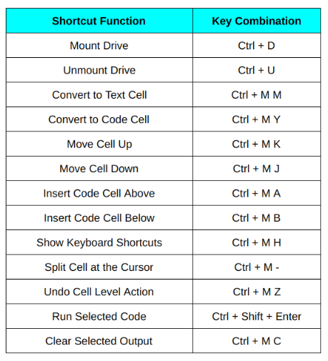
Shortcut keys in Colab
Change shortcut keys by
Going to
Tools 🡺 Keyboard shortcuts
24/43
https://www.analyticsvidhya.com/blog/2020/04/5-amazing-google-colab-hacks-you-should-try-today/#1

Slide 25
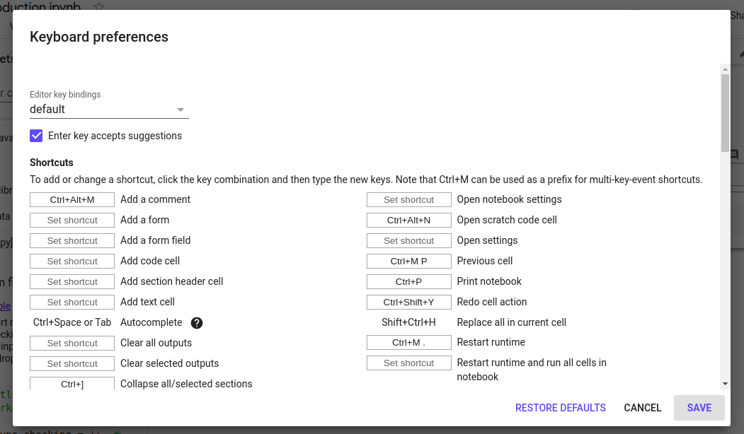
Shortcut keys in Colab
25/43

Slide 26
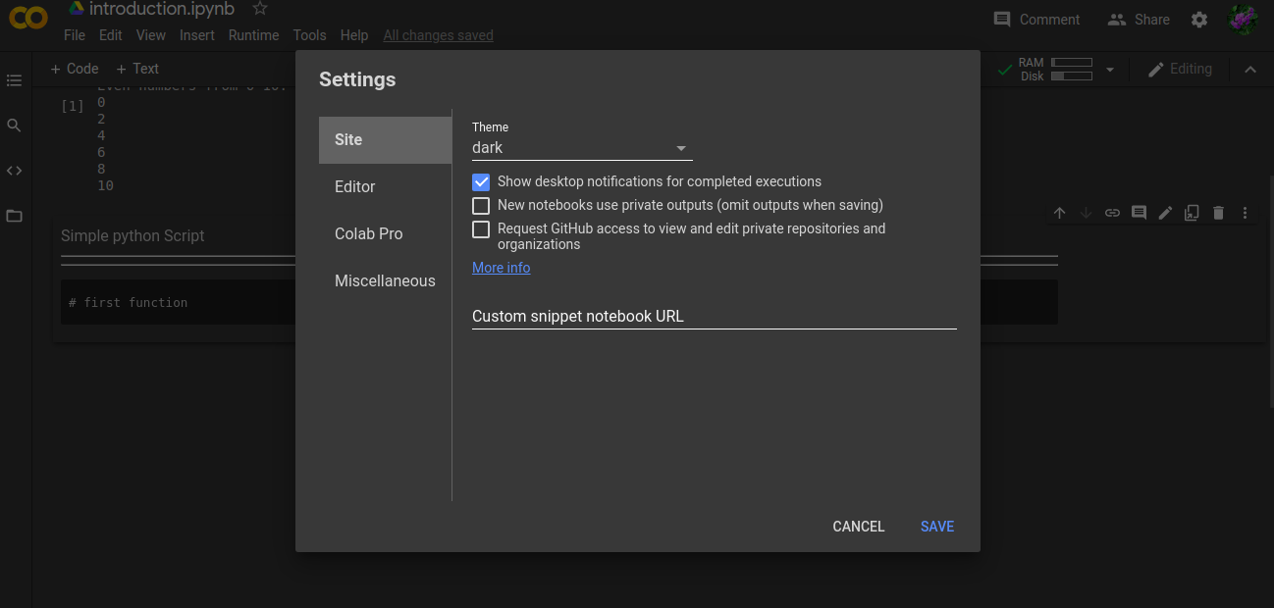
Change mode in Colab
Change to dark mode or light mode by going to Tools 🡺 Settings 🡺 Site
26/43

Slide 27
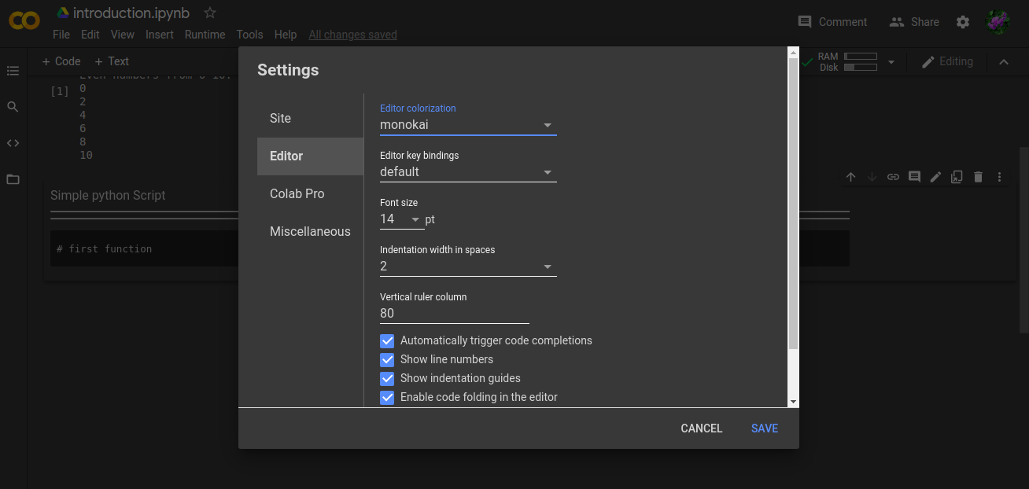
Change mode in Colab
Change editor settings by going to Tools 🡺 Settings 🡺 Editor.
27/43

Slide 28
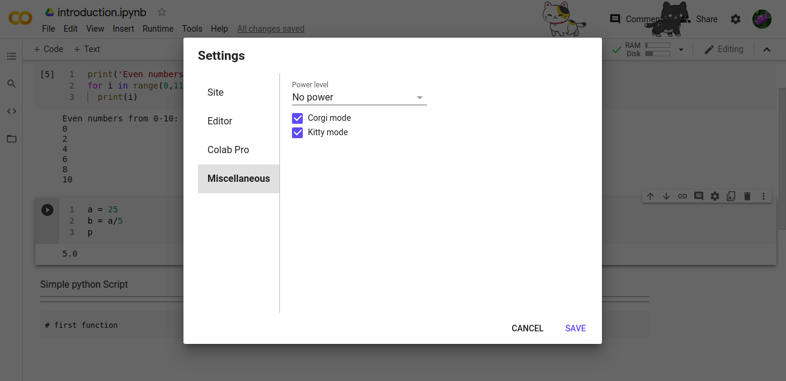
Change mode in Colab
Add animation by going to Tools 🡺 Settings 🡺 Miscellaneous.
28/43

Slide 29
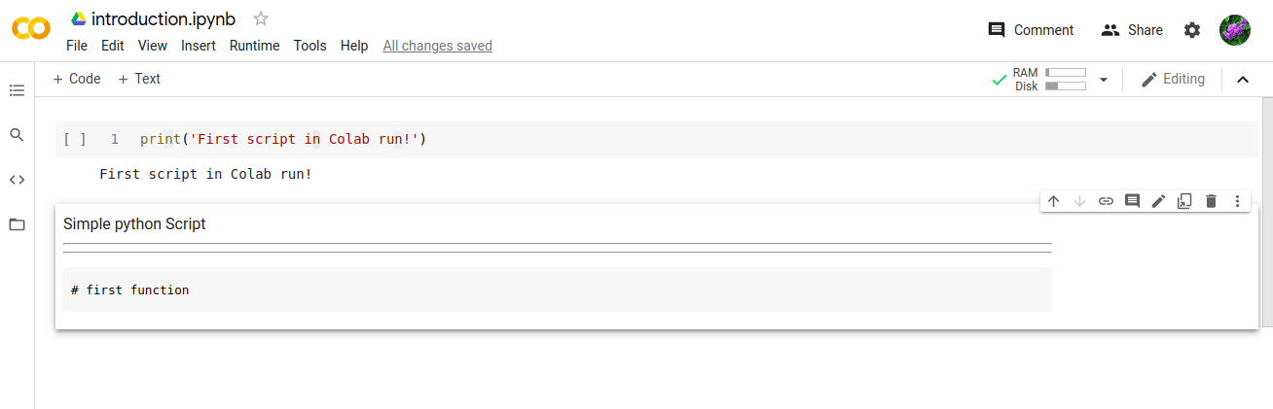
Sharing with Others
You can share your note book by click on share.
29/43

Slide 30
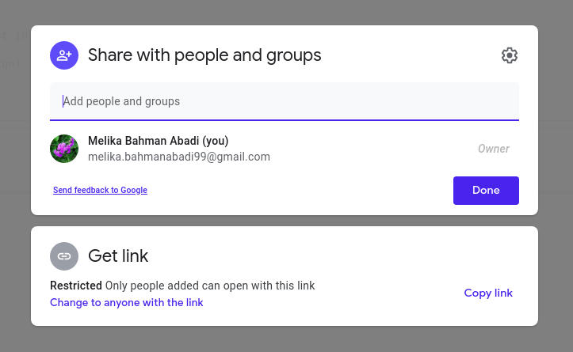
Sharing with Others
The email address of your contact.
1
2
Choose 2 or 3.
2: Colab send email.
3: You can copy and paste link to your contact.
3
30/43

Slide 31
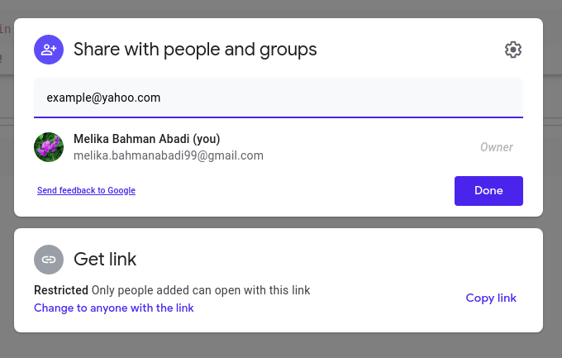
Sharing with Others
The best way.
31/43

Slide 32
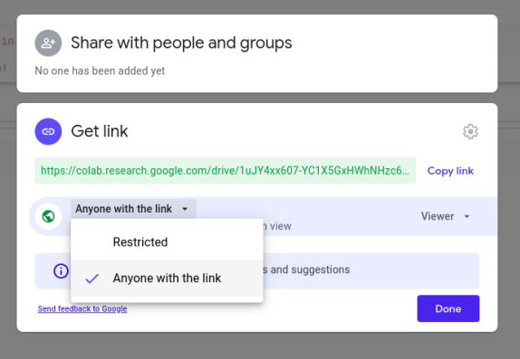
Sharing with Others
Select it.
32/43

Slide 33
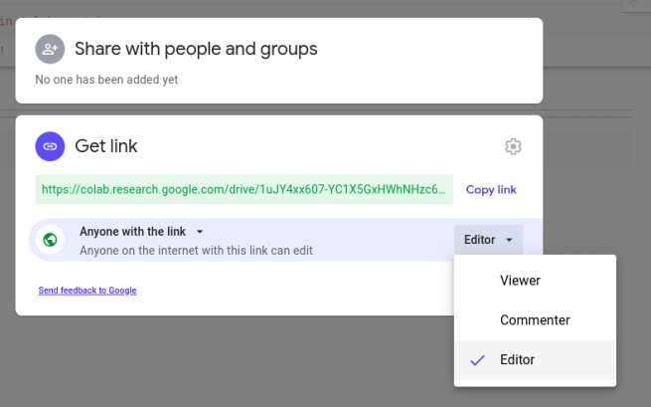
Sharing with Others
In this way your co-worker can coding simultaneously with you!
Select editor. Then your contact can change the codes and run them.
33/43

Slide 34
04
Programming

Slide 35
Simple Programs
Simple calculator
Calculating area
Working with files
Download heavy files with wget command
Image Processing (Flower Recognition)
Data visualization
Life expectancy
Hist and Curve chart
Surface Plot With Contours
35/43

Slide 36
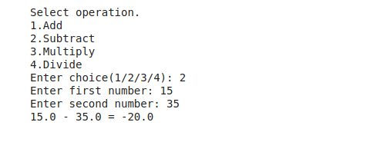
Simple calculator
36/43

Slide 37
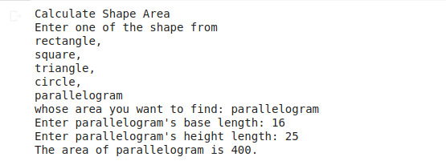
Simple calculator
37/43

Slide 38
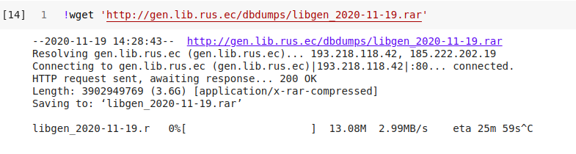
Download heavy files with wget command
38/43

Slide 39
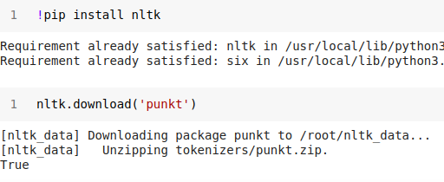
Install framework in Colab
39/43

Slide 40
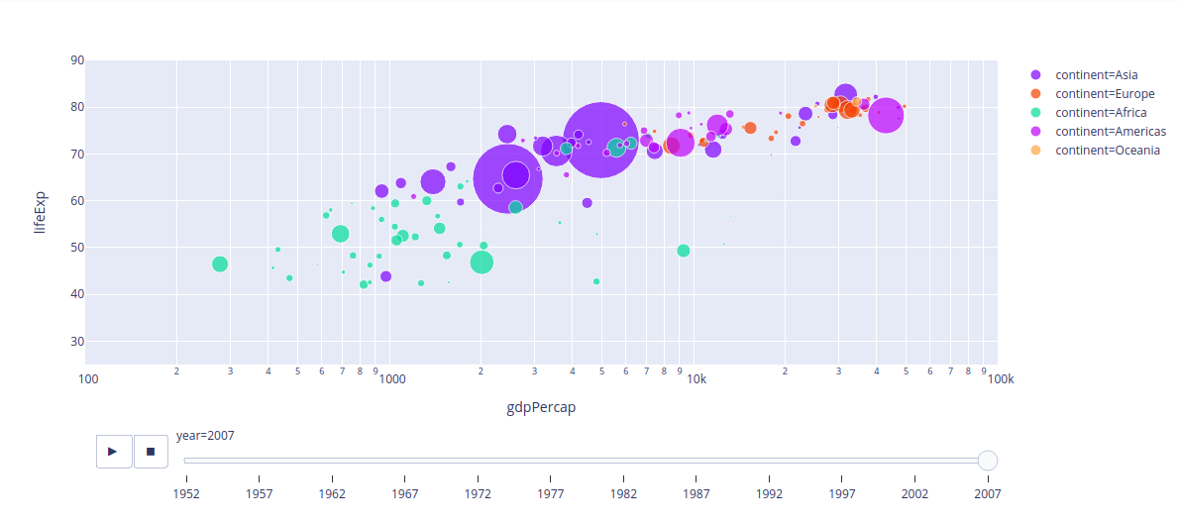
Life expectancy
40/43

Slide 41
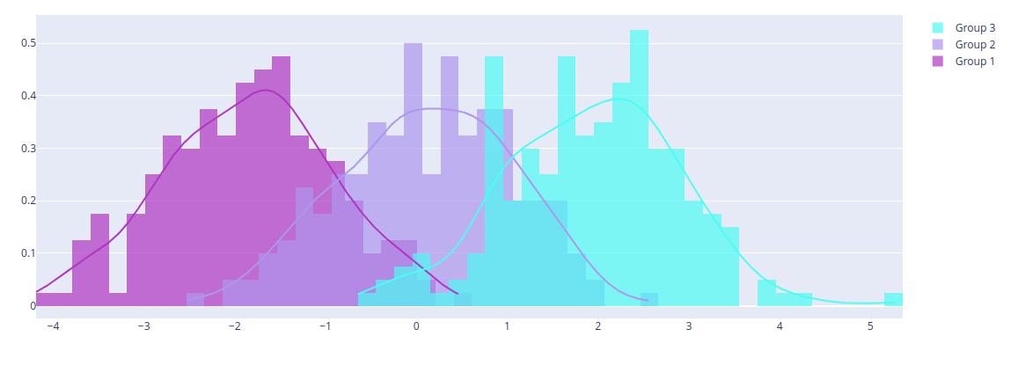
Hist and Curve
41/43

Slide 42
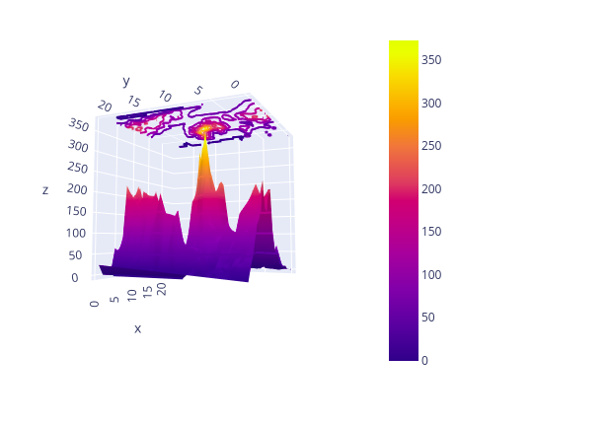
Surface Plot With Contours
42/43

Slide 43
Share this tutorial with other
Note book link:
https://colab.research.google.com/drive/1uJY4xx607-YC1X5GxHWhNHzc6TZkLa7b?usp=sharing
43/43

Slide 44

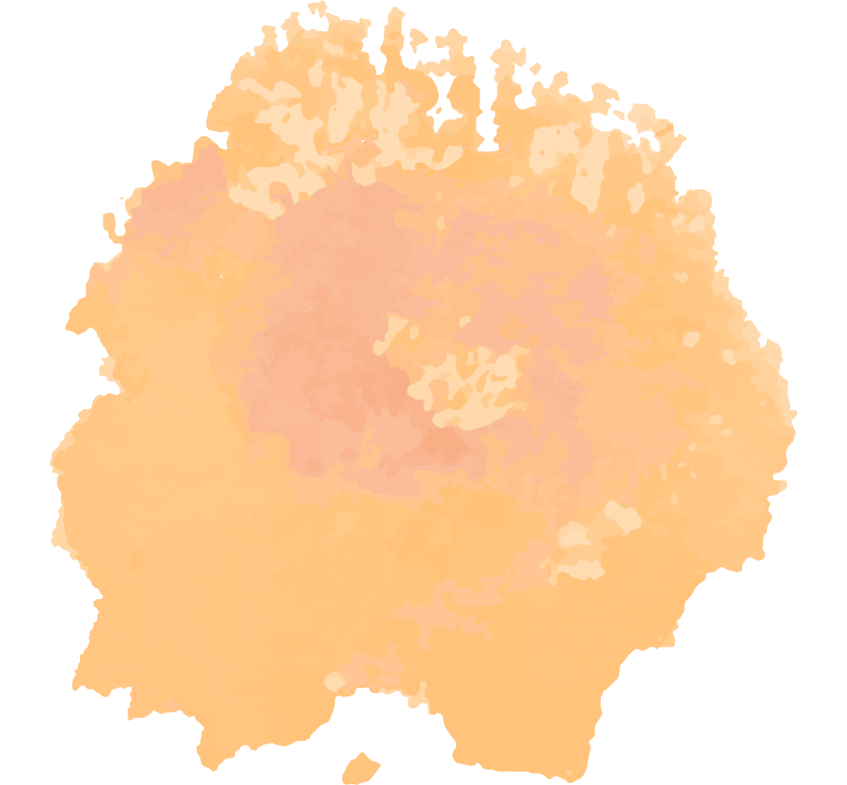
Do you have any questions?
melika.bahmanabadi99@gmail.com https://ir.linkedin.com/in/melika-bahman-abadi-6729aa19a

Slide 45
Resources
https://www.analyticsvidhya.com/blog/2020/04/5-amazing-google-colab-hacks-you-should-try-today/#1
https://iq.opengenus.org/cpu-vs-gpu-vs-tpu/
https://heartbeat.fritz.ai/step-by-step-use-of-google-colab-free-tpu-75f8629492b3
https://www.kdnuggets.com/2018/05/wtf-tensor.html
https://www.analyticsvidhya.com/blog/2020/04/5-amazing-google-colab-hacks-you-should-try-today/#1
https://plotly.com/python/animations/
https://www.marktechpost.com/2019/06/07/how-to-connect-google-colab-with-google-drive/
https://hackintos.com/download-anything-to-google-drive-using-google-colab/

